Slide 1
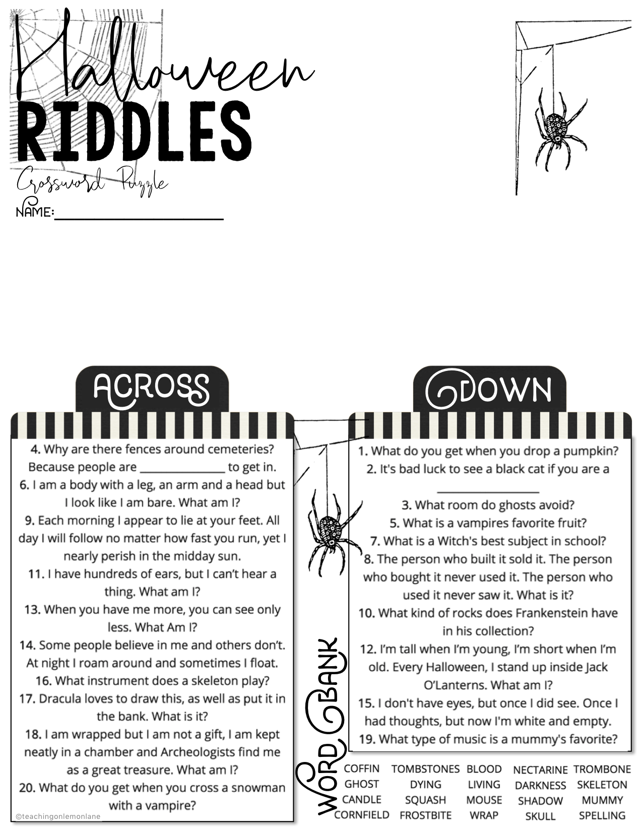
1
2
3
4
5
6
7
8
IF COMPLETING THE PUZZLE DIGITALLY THROUGH GOOGLE SLIDES, ZOOM IN TO AT LEAST 100% IN ORDER TO BETTER BE ABLE TO CLICK ON THE SQUARES INDIVIDUALLY AND ADD YOUR LETTERS. 200% ZOOM WORKS GREAT AS WELL!
IN ORDER TO ZOOM IN. CLICK [ VIEW ] IN THE TOOLBOX. THEN CLICK [ ZOOM ] THEN SELECT THE PERCENTAGE, OR CLICK ZOOM IN UNTIL HAPPY WITH THE LAYOUT.
9
10
11
12
13
14
15
16
17
18
19
20

Slide 2
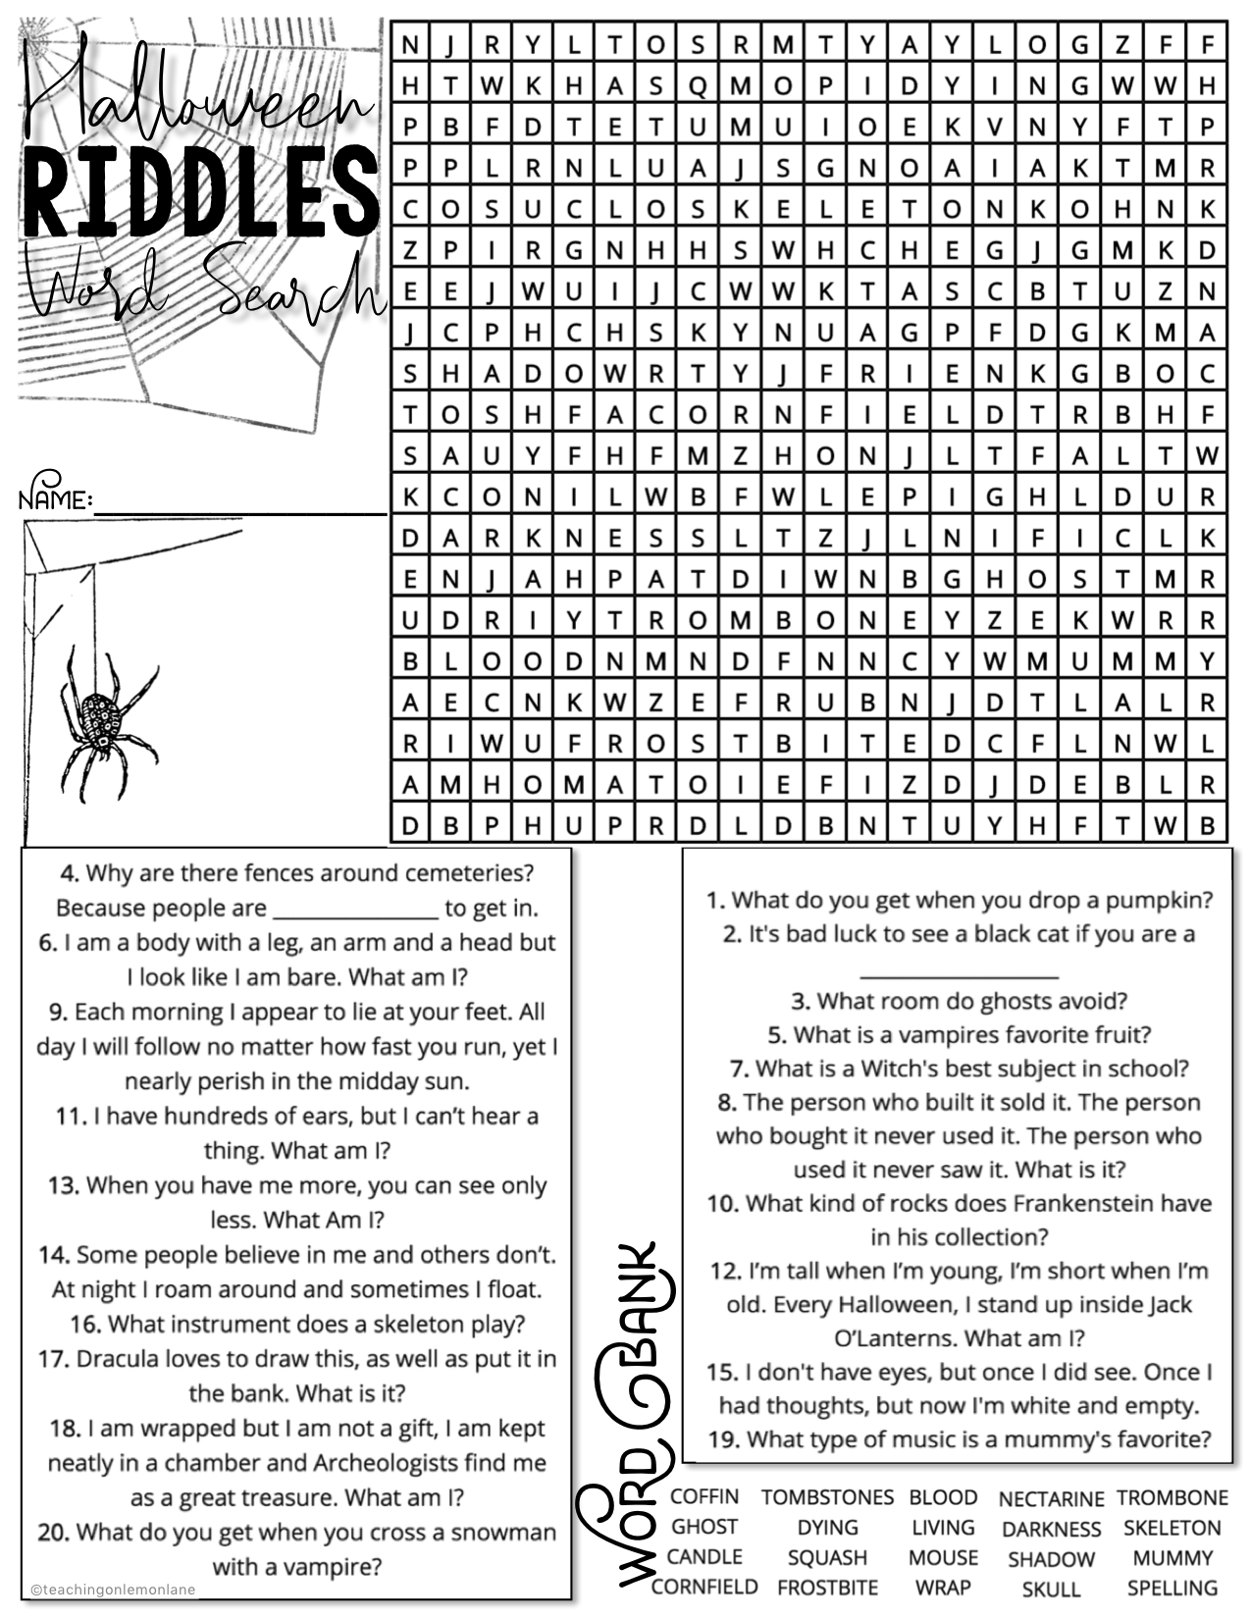
IF COMPLETING THE PUZZLE DIGITALLY THROUGH GOOGLE SLIDES, ZOOM IN TO AT LEAST 100% IN ORDER TO BETTER BE ABLE TO select the words using the highlight tools to the right.
To highlight simply place the shape over the letters and adjust the size.
IN ORDER TO ZOOM IN. CLICK [ VIEW ] IN THE TOOLBOX. THEN CLICK [ ZOOM ] THEN SELECT THE PERCENTAGE, OR CLICK ZOOM IN UNTIL HAPPY WITH THE LAYOUT.

